Slide 1
ROW-ECHELON FORM AND REDUCED ROW-ECHELON FORM
MATH 15 - Linear Algebra

Slide 2
DEFINITION
A matrix is in Reduced Row Echelon Form (RREF) if it satisfies the following:
A zero row (row containing entirely of zeroes), if it exists, appear at the bottom of the matrix
The first non zero element in a row is a 1. This is known as the leading one.
The next leading one appears below and to the right of the preceding leading one.
The leading one is the only non zero element in its column.
If A, B and C are satisfied, the matrix is in Row Echelon Form.

Slide 3
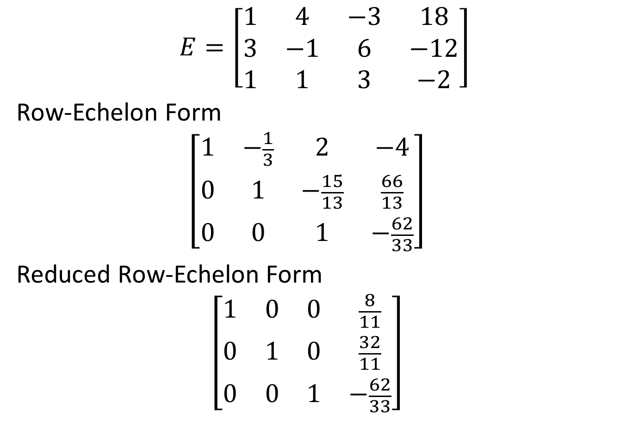
EXAMPLE
$$E=\left[\begin{matrix}1 & 4 & −3 & 18 \\ 3 & −1 & 6 & −12 \\ 1 & 1 & 3 & −2\end{matrix}\right]$$
Row-Echelon Form
$$\left[\begin{matrix}1 & −\frac{1}{3} & 2 & −4 \\ 0 & 1 & −\frac{15}{13} & \frac{66}{13} \\ 0 & 0 & 1 & −\frac{62}{33}\end{matrix}\right]$$
Reduced Row-Echelon Form
$$\left[\begin{matrix}1 & 0 & 0 & \frac{8}{11} \\ 0 & 1 & 0 & \frac{32}{11} \\ 0 & 0 & 1 & −\frac{62}{33}\end{matrix}\right]$$

Slide 4
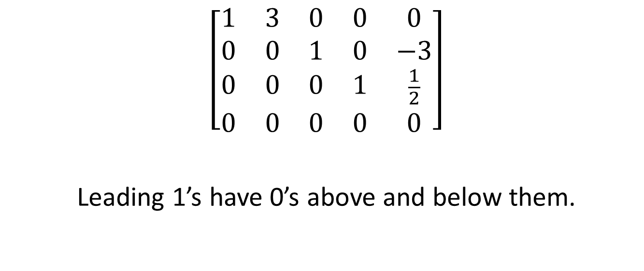
REDUCED ROW-ECHELON FORM
$$\left[\begin{matrix}1 & 3 & 0 & 0 & 0 \\ 0 & 0 & 1 & 0 & −3 \\ 0 & 0 & 0 & 1 & \frac{1}{2} \\ 0 & 0 & 0 & 0 & 0\end{matrix}\right]$$
Leading 1’s have 0’s above and below them.

Slide 5
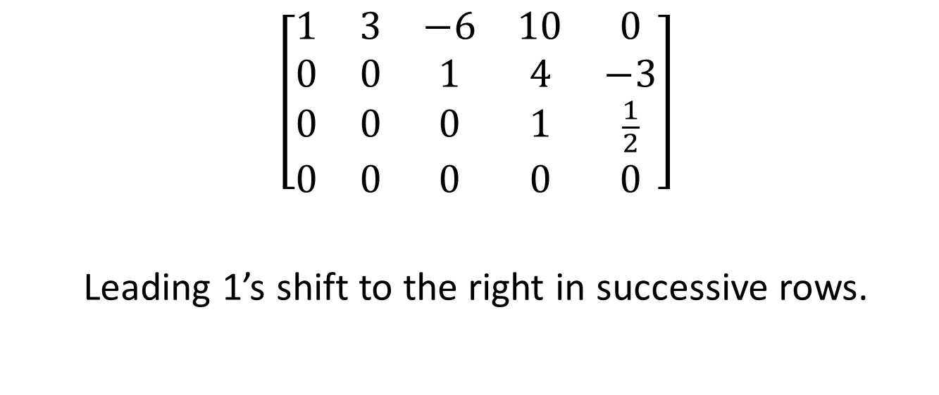
ROW-ECHELON FORM
$$\left[\begin{matrix}1 & 3 & −6 & 10 & 0 \\ 0 & 0 & 1 & 4 & −3 \\ 0 & 0 & 0 & 1 & \frac{1}{2} \\ 0 & 0 & 0 & 0 & 0\end{matrix}\right]$$
Leading 1’s shift to the right in successive rows.

Slide 6
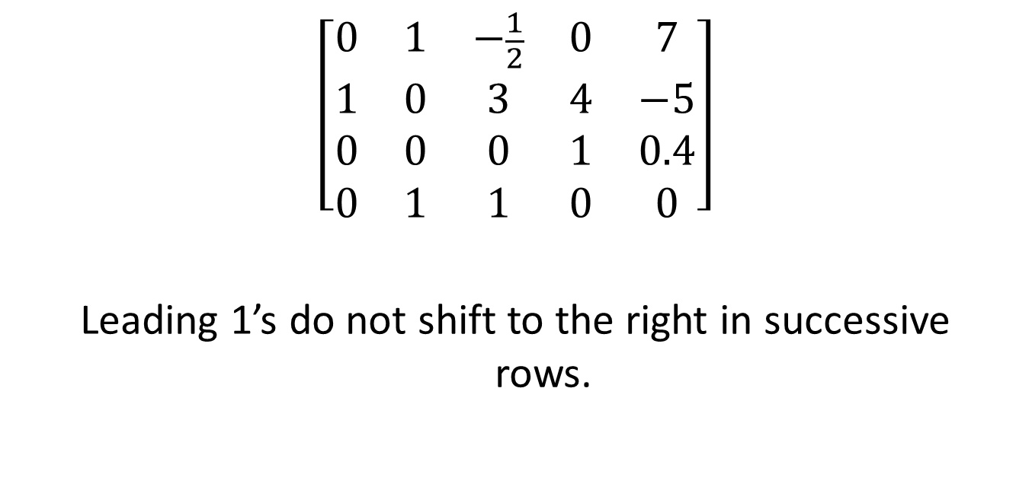
NOT IN ROW-ECHELON FORM
$$\left[\begin{matrix}0 & 1 & −\frac{1}{2} & 0 & 7 \\ 1 & 0 & 3 & 4 & −5 \\ 0 & 0 & 0 & 1 & 0.4 \\ 0 & 1 & 1 & 0 & 0\end{matrix}\right]$$
Leading 1’s do not shift to the right in successive rows.

Slide 7
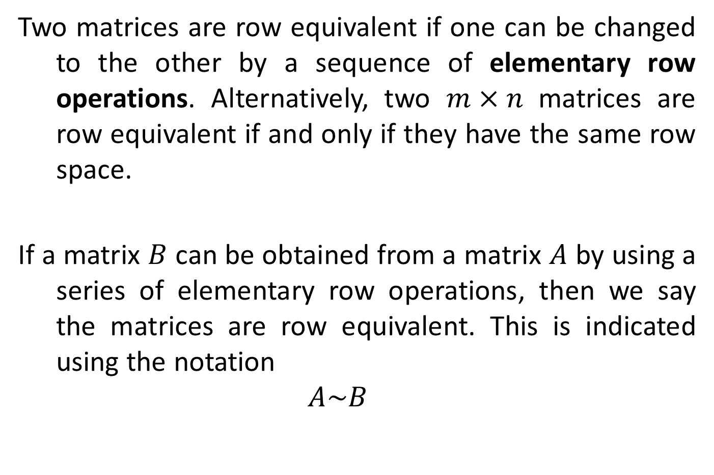
ROW EQUIVALENCE
Two matrices are row equivalent if one can be changed to the other by a sequence of elementary row operations. Alternatively, two $m×n$ matrices are row equivalent if and only if they have the same row space.
If a matrix $B$ can be obtained from a matrix $A$ by using a series of elementary row operations, then we say the matrices are row equivalent. This is indicated using the notation
$$A\sim B$$

Slide 8
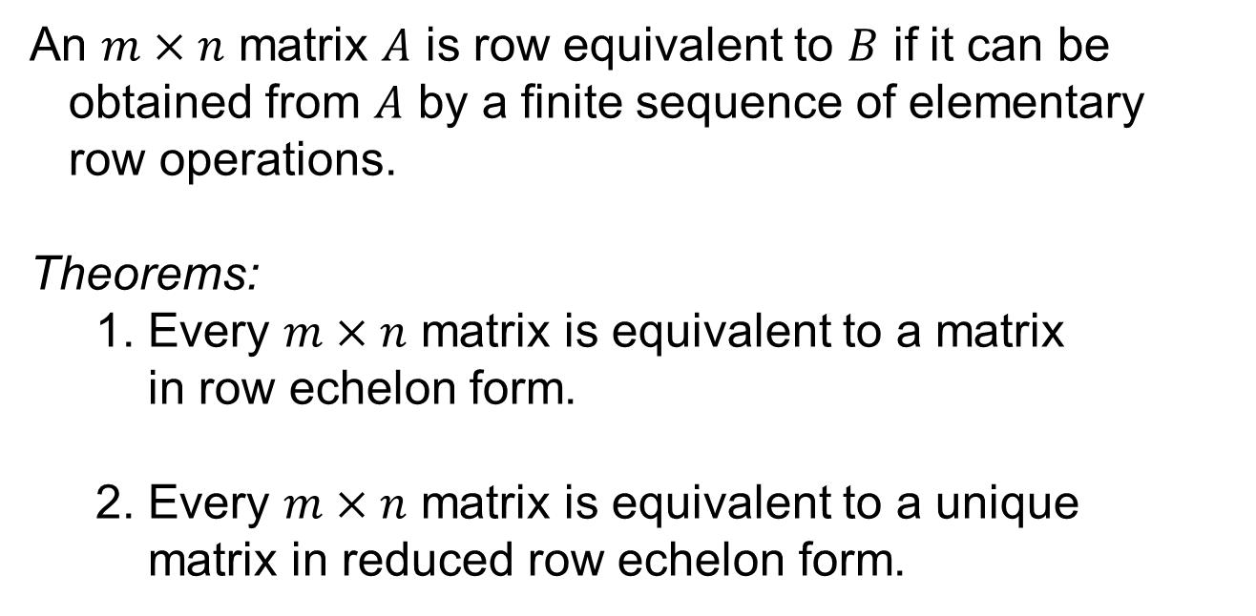
ROW EQUIVALENCE
An $m×n$ matrix $A$ is row equivalent to $B$ if it can be
obtained from $A$ by a finite sequence of elementary
row operations.
Theorems:
1. Every $m×n$ matrix is equivalent to a matrix
in row echelon form.
2. Every $m×n$ matrix is equivalent to a unique
matrix in reduced row echelon form.

Slide 9
ELEMENTARY ROW OPERATIONS
An elementary row operation is any one of the following moves:
Swap: Swap two rows of a matrix.
Scale: Multiply a row of a matrix by a nonzero constant
Pivot: Add to one row of a matrix some multiple of another row.

Slide 10
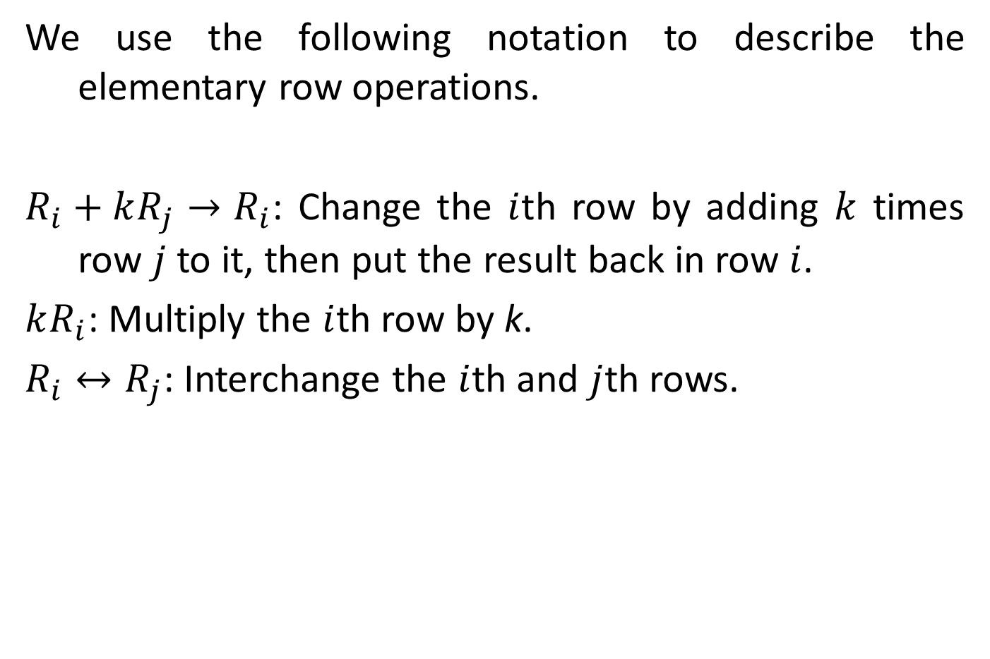
ELEMENTARY ROW OPERATIONS
We use the following notation to describe the elementary row operations.
$R_{i}+kR_{j}→R_{i}$: Change the $i$th row by adding $k$ times row $j$ to it, then put the result back in row $i$.
$kR_{i}$: Multiply the $i$th row by k.
$R_{i}↔R_{j}$: Interchange the $i$th and $j$th rows.

Slide 11
REDUCTION TO ROW-ECHELON FORM
Here is a systematic way to put a matrix in row-echelon form using elementary row operations.
Start by obtaining 1 in the top left corner. Then obtain zeros below that 1 by adding appropriate multiples of the first row to the rows below it.
Next, obtain a leading 1 in the next row, and then obtain zeros below that 1.
At each stage make sure that every leading entry is to the right of the leading entry in the row above it−rearrange the rows if necessary.
Continue this process until you arrive at a matrix in row-echelon form.

Slide 12
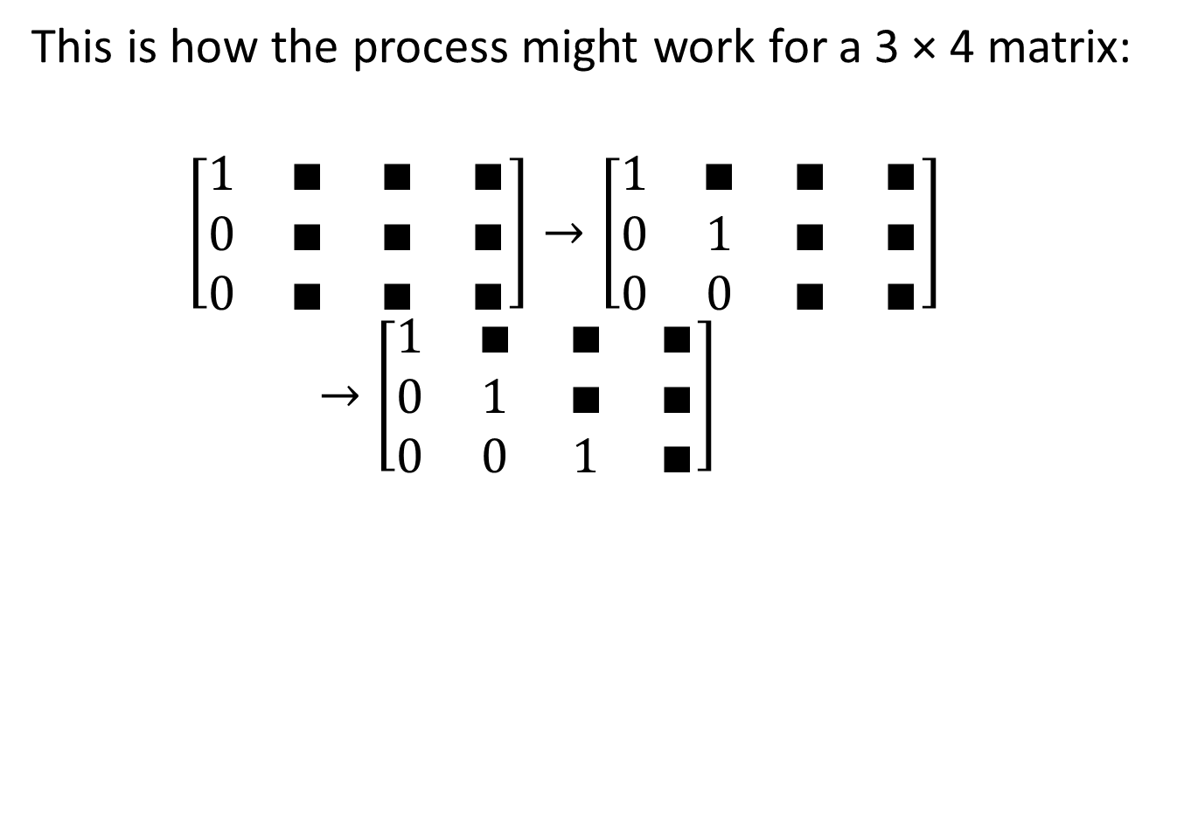
REDUCTION TO ROW-ECHELON FORM
This is how the process might work for a 3 × 4 matrix:
$$\left[\begin{matrix}1 & ∎ & ∎ & ∎ \\ 0 & ∎ & ∎ & ∎ \\ 0 & ∎ & ∎ & ∎\end{matrix}\right]→\left[\begin{matrix}1 & ∎ & ∎ & ∎ \\ 0 & 1 & ∎ & ∎ \\ 0 & 0 & ∎ & ∎\end{matrix}\right]→\left[\begin{matrix}1 & ∎ & ∎ & ∎ \\ 0 & 1 & ∎ & ∎ \\ 0 & 0 & 1 & ∎\end{matrix}\right]$$

Slide 13
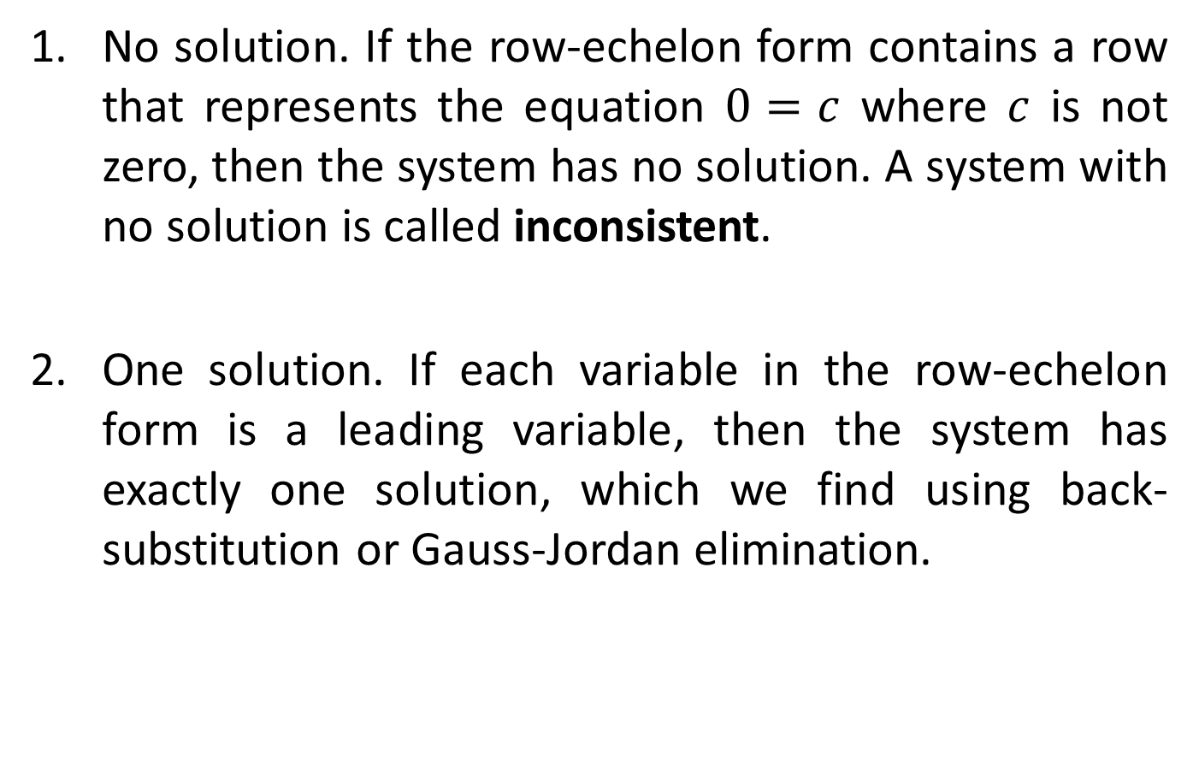
THE SOLUTIONS OF A LINEAR SYSTEM IN ROW-ECHELON FORM
No solution. If the row-echelon form contains a row that represents the equation $0=c$ where $c$ is not zero, then the system has no solution. A system with no solution is called inconsistent.
One solution. If each variable in the row-echelon form is a leading variable, then the system has exactly one solution, which we find using back-substitution or Gauss-Jordan elimination.

Slide 14
THE SOLUTIONS OF A LINEAR SYSTEM IN ROW-ECHELON FORM
Infinitely many solutions. If the variables in the row-echelon form are not all leading variables, and if the system is not inconsistent, then it has infinitely many solutions. In this case, the system is called dependent. We solve the system by putting the matrix in reduced row-echelon form and then expressing the leading variables in terms of the nonleading variables. The nonleading variables may take on any real numbers as their values.

Slide 15
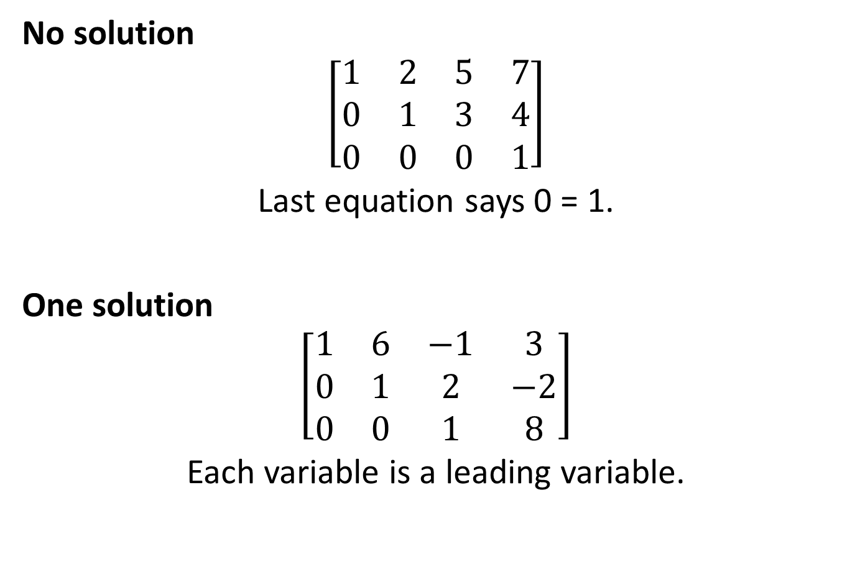
THE SOLUTIONS OF A LINEAR SYSTEM IN ROW-ECHELON FORM
No solution
$$\left[\begin{matrix}1 & 2 & 5 & 7 \\ 0 & 1 & 3 & 4 \\ 0 & 0 & 0 & 1\end{matrix}\right]$$
Last equation says 0 = 1.
One solution
$$\left[\begin{matrix}1 & 6 & −1 & 3 \\ 0 & 1 & 2 & −2 \\ 0 & 0 & 1 & 8\end{matrix}\right]$$
Each variable is a leading variable.

Slide 16

THE SOLUTIONS OF A LINEAR SYSTEM IN ROW-ECHELON FORM
Infinitely many solutions
$$\left[\begin{matrix}1 & 2 & −3 & 1 \\ 0 & 1 & 5 & −2 \\ 0 & 0 & 0 & 0\end{matrix}\right]$$
$z$ is not a leading variable.

